Slide 1
Sekapur Sirih Jaringan Komputer
Gandeva Bayu Satrya (GBS)
gbs@ittelkom.ac.id
gandeva.bayu.s@gmail.com
TELKOM ENGINEERING SCHOOL
Telkom University

Slide 2


References

Slide 3

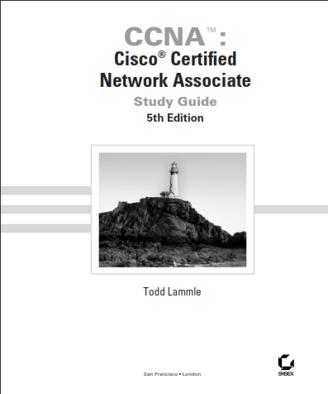
Add. References

Slide 4
References Details
Chapter 1 : Comp.Net & The Internet
Chapter 2 : Application Layer
Chapter 3 : Transport Layer
Chapter 4 : Network Layer
Chapter 5 : Link Layer and LANs
Chapter 6 : Wireless and Mobile Net.
Chapter 7 : Multimedia Networking
Chapter 8 : Security in Comp.Net
Chapter 9 : Network Management

Slide 5
Rules
Use 2012’ s Curiculum
Scoring
Pre, Post, & Task (SCL) : 15%
Attitute (SCL) : 10%
Mid Test : 35%
Final Test : 40%
Penalty
Plagiarism → E
Attendance → >= 75% (Roster)

Slide 6
CHAPTER 1 FOUNDATION
Gandeva Bayu Satrya (GBS)
gbs@ittelkom.ac.id
gandeva.bayu.s@gmail.com
TELKOM ENGINEERING SCHOOL
Telkom University

Slide 7
Agenda
Chapter 1. Comp.Net & The Internet
1.1 Application
1.2 Requirements
1.3 Net. Architecture
1.4 Internet
1.5 Implementing Net Soft.
1.6 Performance

Slide 8
Application
Most people know about the Internet (a computer network) through applications
World Wide Web
Email
Online Social Network
Streaming Audio Video
File Sharing
Instant Messaging
…

Slide 9
Application
URL
Uniform resource locater
http://www.cs.princeton.edu/~llp/index.html
HTTP
Hyper Text Transfer Protocol
TCP
Transmission Control Protocol
17 messages for one URL request
6 to find the IP (Internet Protocol) address
3 for connection establishment of TCP
4 for HTTP request and acknowledgement
Request: I got your request and I will send the data
Reply: Here is the data you requested; I got the data
4 messages for tearing down TCP connection

Slide 10
Agenda
Chapter 1. Comp.Net & The Internet
1.1 Application
1.2 Requirements
1.3 Net. Architecture
1.4 Internet
1.5 Implementing Net Soft.
1.6 Performance

Slide 11
Requirement : Perspectives
Application Programmer
List the services that his application needs: delay bounded delivery of data
Network Designer
Design a cost-effective network with sharable resources
Network Provider
List the characteristics of a system that is easy to manage

Slide 12
Requirement : Connectivity
Need to understand the following terminologies
Scale
Link
Nodes
Point-to-point
Multiple access
Switched Network
Circuit Switched
Packet Switched
Store-and-forward

Slide 13
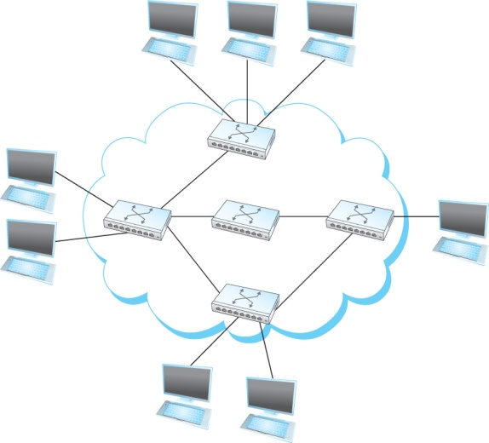
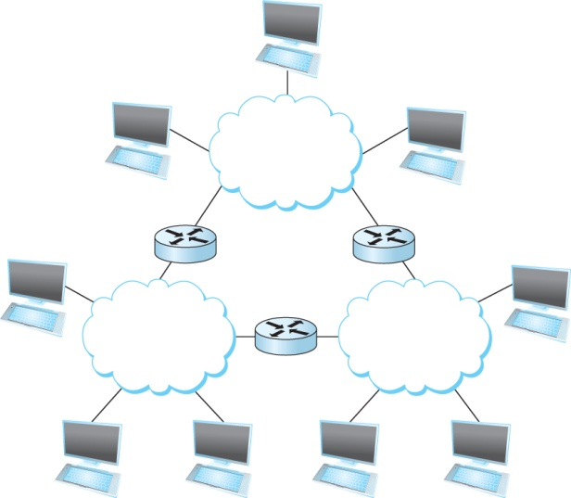
Requirement : Connectivity
Terminologies (contd.)
Cloud
Hosts
Switches
internetwork
Router/gateway
Host-to-host connectivity
Address
Routing
Unicast/broadcast/multicast
(a)
(b)
A switched network
Interconnection of networks

Slide 14
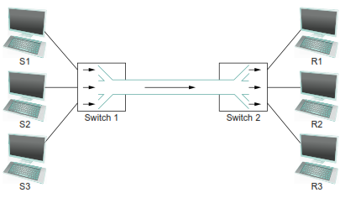
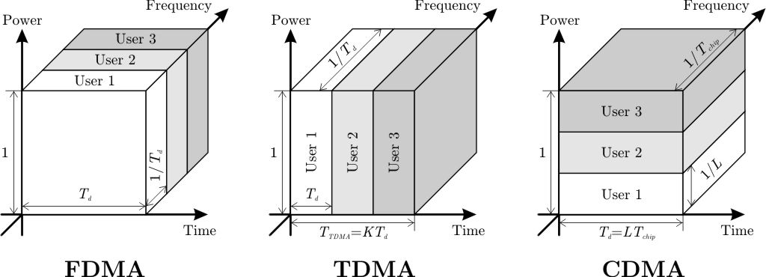
Requirement : Resource Sharing

Slide 15
Agenda
Chapter 1. Comp.Net & The Internet
1.1 Application
1.2 Requirements
1.3 Net. Architecture
1.4 Internet
1.5 Implementing Net Soft.
1.6 Performance

Slide 16
Network Architecture
a computer network must provide general, cost-effective, fair, and robust connectivity among a large number of computers.
network designers have developed general blueprints—usually called network architectures—that guide the design and implementation of networks

Slide 17

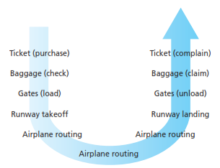
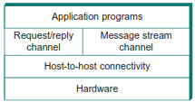

Network Architecture
Analogy TCP/IP OSI

Slide 18
Protocols
Protocol defines the interfaces between the layers in the same system and with the layers of peer system
Building blocks of a network architecture
Each protocol object has two different interfaces
service interface: operations on this protocol
peer-to-peer interface: messages exchanged with peer

Slide 19
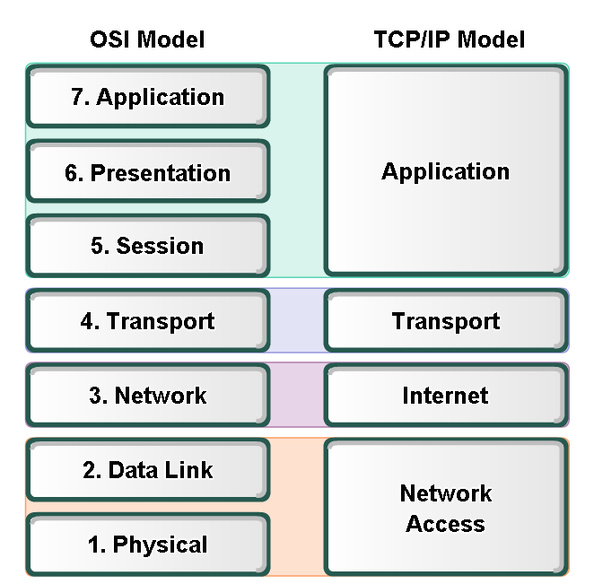
Protocol Data Unit
PDU
DATA
SEGMENT
PACKET
FRAME
BITS

Slide 20
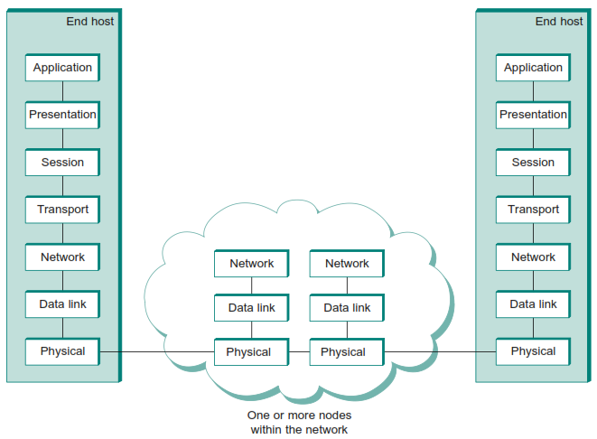
Encapsulation, Mux, & DeMux

Slide 21
Agenda
Chapter 1. Comp.Net & The Internet
1.1 Application
1.2 Requirements
1.3 Net. Architecture
1.4 Internet
1.5 Implementing Net Soft.
1.6 Performance

Slide 22

1.1 What is the Internet?
Internet: “network of networks”
loosely hierarchical
public Internet versus private intranet
Internet standards
RFC: Request for comments
IETF: Internet Engineering Task Force
IANA : Internet Assigned Numbers Authority
http://www.ietf.org/rfc.html

Slide 23
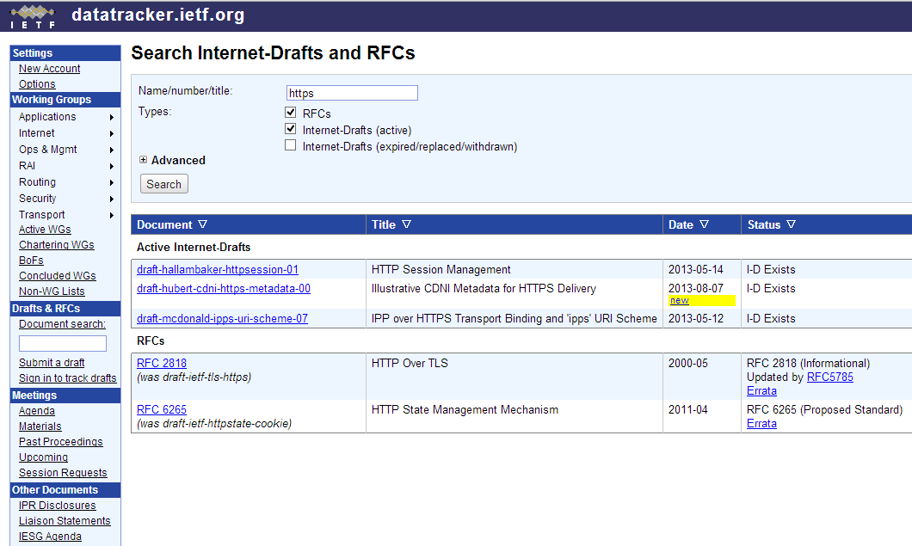

Slide 24
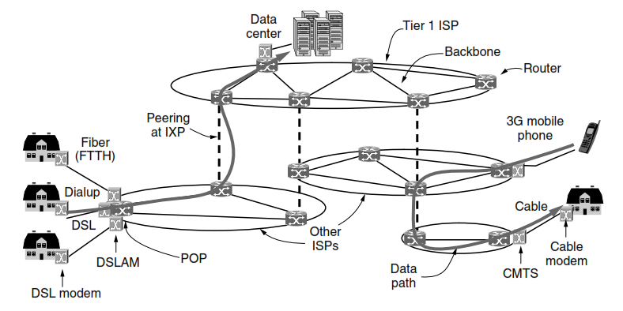
Internet ^{[Tanenbaum 2011]}
The Internet is not really a network at all, but a vast collection of different networks that use certain common protocols and provide certain common services.

Slide 25
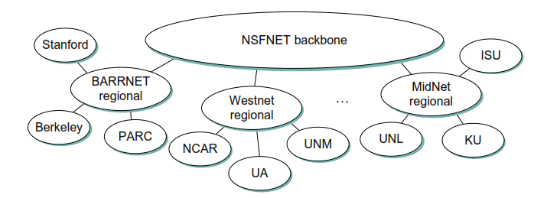
Internet ^{[Perterson 2012]}
Internet in 1990’s
... how to connect a heterogeneous collection of networks to create an internetwork and how to use the simple hierarchy of the IP address to make routing in an internet somewhat scalable.

Slide 26
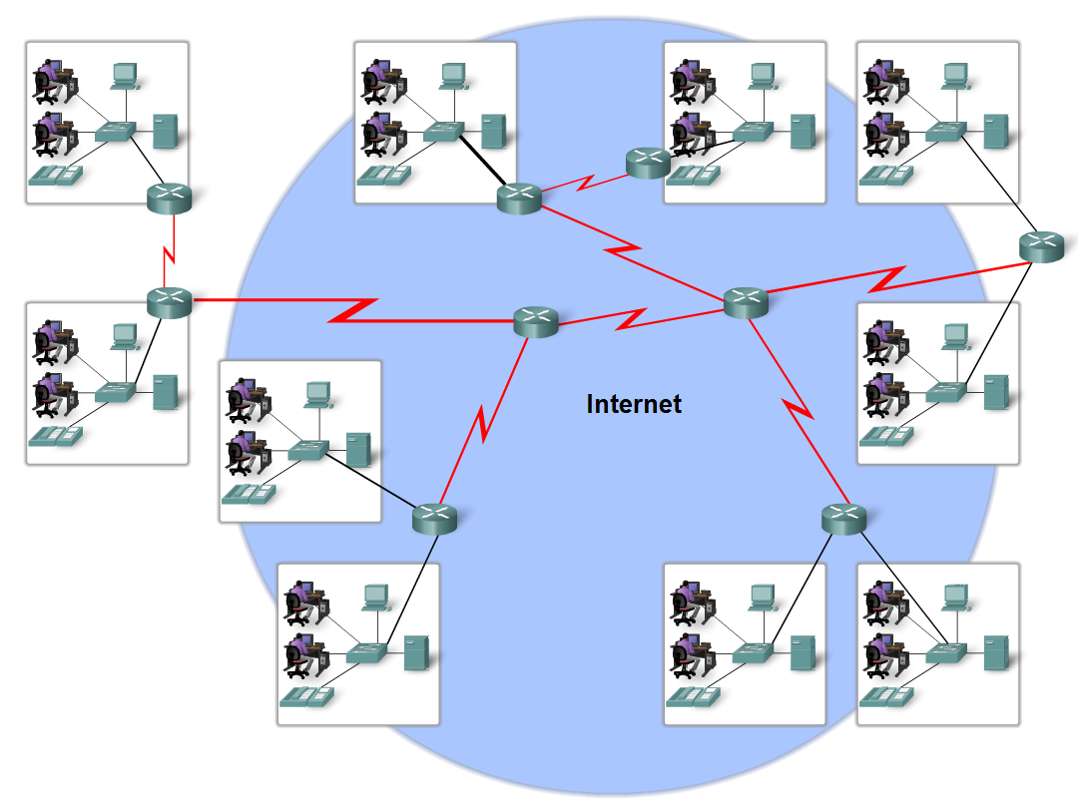
Internet ^{[Lammle 2005]}
The internet is defined as a global mesh of interconnected networks ...

Slide 27
Agenda
Chapter 1. Comp.Net & The Internet
1.1 Application
1.2 Requirements
1.3 Net. Architecture
1.4 Internet
1.5 Implementing Net Soft.
1.6 Performance

Slide 28
API
Interface exported by the network
Since most network protocols are implemented (those in the high protocol stack) in software and nearly all computer systems implement their network protocols as part of the operating system, when we refer to the interface “exported by the network”, we are generally referring to the interface that the OS provides to its networking subsystem
The interface is called the network Application Programming Interface (API)

Slide 29
API (sockets)
Socket Interface was originally provided by the Berkeley distribution of Unix
- Now supported in virtually all operating systems
Each protocol provides a certain set of services, and the API provides a syntax by which those services can be invoked in this particular OS.

Slide 30
Socket
What is a socket?
The point where a local application process attaches to the network
An interface between an application and the network
An application creates the socket
The interface defines operations for
Creating a socket
Attaching a socket to the network
Sending and receiving messages through the socket
Closing the socket

Slide 31
Agenda
Chapter 1. Comp.Net & The Internet
1.1 Application
1.2 Requirements
1.3 Net. Architecture
1.4 Internet
1.5 Implementing Net Soft.
1.6 Performance

Slide 32
Bandwidth
Bandwidth
Width of the frequency band
Number of bits per second that can be transmitted over a communication link
Example :
1 Mbps: 1 x 10⁶ bits/second
meaning that it is able to deliver 10 million bits every second
Bandwidth and throughput are two of the most confusing terms used in networking. What is The Difference?
Notes:
If you see the word bandwidth used in a situation in which it is being measured in hertz, then it probably refers to the range of signals that can be accommodated.
A useful distinction can also be made, however, between the maximum data rate that is available on the link and the number of bits per second that we can actually transmit over the link in practice. We tend to use the word throughput to refer to the measured performance of a system.

Slide 33
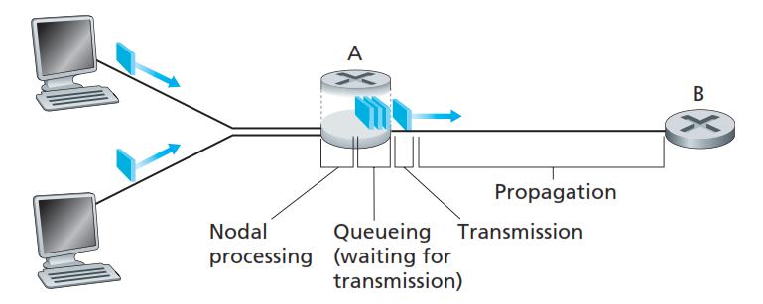
Latency (delay)
Latency = Propagation + transmit + queue
Propagation = distance/speed of light
Transmit = size/bandwidth

Slide 34

Delay X Bandwidth
We think the channel between a pair of processes as a hollow pipe
Latency (delay) length of the pipe and bandwidth the width of the pipe
Delay of 50 ms and bandwidth of 45 Mbps
50 x 10⁻³ seconds x 45 x 10⁶ bits/second
2.25 x 10⁶ bits = 280 KB data.

Slide 35
Throughput
Throughput = TransferSize/TransferTime
TransferTime = RTT +1/Bandwidth ×TransferSize
Example :
where a user wants to fetch a 1-MB ﬁle across a 1-Gbps network with a round-trip time of 100 ms.
The TransferTime includes both the transmit time for 1 MB (1/1 Gbps ×1 MB = 8 ms) and the 100-ms RTT, for a total transfer time of 108 ms.
This means that the effective throughput will be
1 MB/108 ms = 74.1 Mbps

Slide 36
Throughput (con’t)
Another Example :
Suppose one wants to stream a video that is one quarter the size of a standard TV screen; that is, it has a resolution of 352 by 240 pixels.
If each pixel is represented by 24 bits of information, as would be the case for 24-bit color, then the size of each frame would be
(352 ×240 ×24)/8 = 247.5 KB
If the application needs to support a frame rate of 30 frames per second, then it might request a throughput rate of 75 Mbps.

Slide 37
Packet Loss
Instead, a packet can arrive to find a full queue. With no place to store such a packet, a router will drop that packet; that is, the packet will be lost.
a packet loss will look like a packet having been transmitted into the network core but never emerging from the network at the destination.
The fraction of lost packets increases as the traffic intensity increases.

Slide 38
Bibliography
Kurose, J.F., and Ross, K.W., Computer Networking : A Top-Down Approach Sixth Edition, Pearson Education, Inc. USA, 2013.
Peterson, L.L., and Davie, B.S., Computer Networks: A Systems Approach Fifth Edition, Morgan Kaufmann, Burlington USA, 2012.
Tanenbaum, A.S., and Wetherall, D.J., Computer Networks Fifth Edition, Pearson Education, Inc., Boston USA, 2011.
Lammle T., Cisco Certified Network Associate : Study Guide Fifth Edition, Sybex, Inc. USA, 2005.

Slide 39
THANK YOU
Gandeva Bayu Satrya (GBS)
gbs@ittelkom.ac.id
gandeva.bayu.s@gmail.com
TELKOM ENGINEERING SCHOOL
Telkom University

